Slide 1

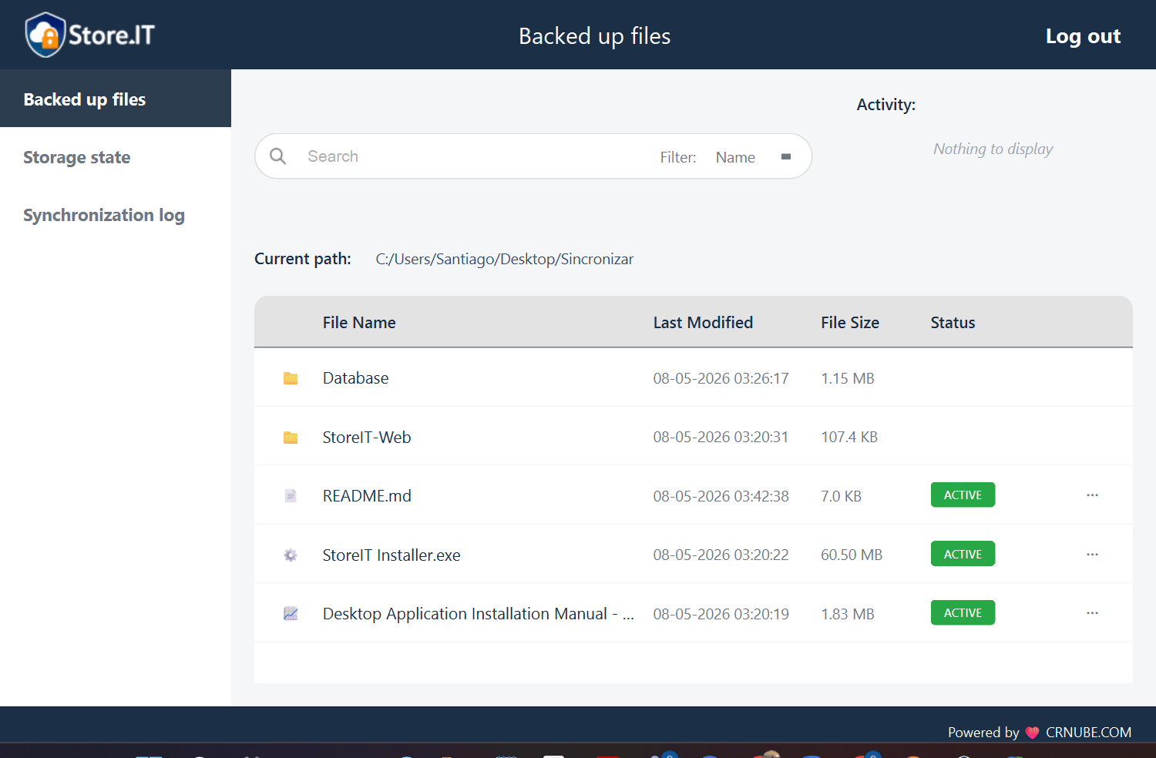

StoreIT Desktop Installation Manual

Slide 2
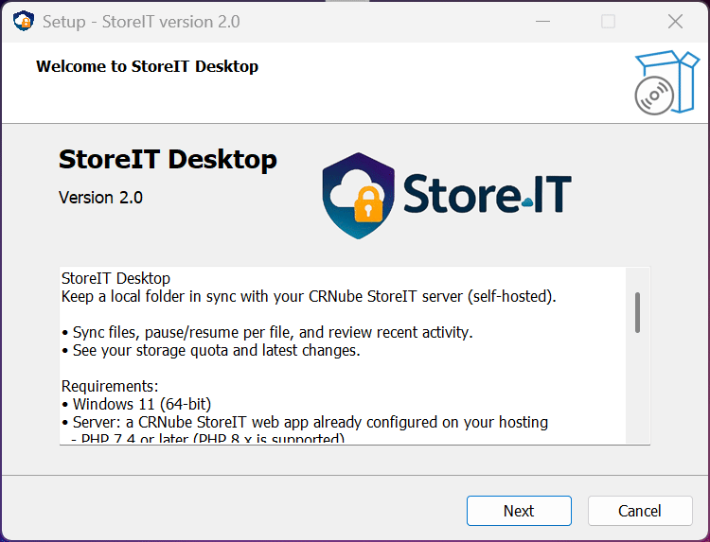
Step #1
Open the installer, named StoreIInstaller.exe, read the welcome message, and then click Next.

Slide 3
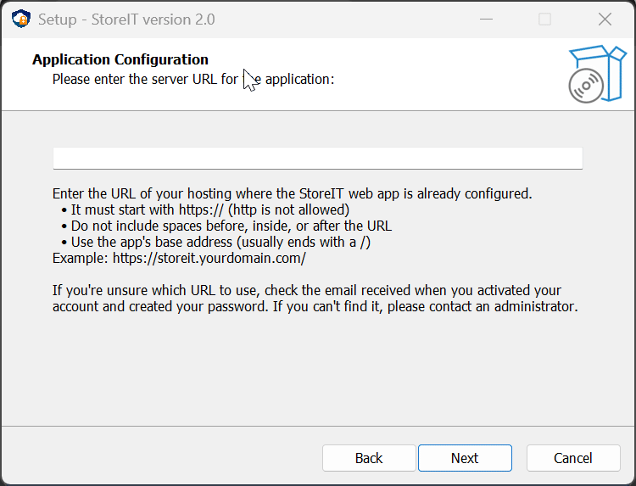
Step #2
Enter the URL of the hosting where StoreIT Web is installed. You can find it in the email you received when you activated your account, or you can get it directly from the corresponding page. Then, click Next.

Slide 4
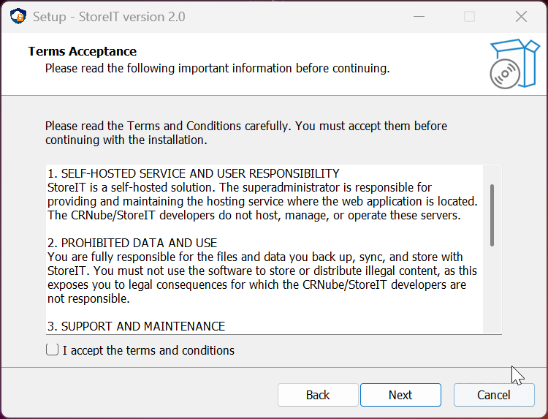
Step #3
Read the terms and conditions of the application. Then, accept them and click Next.

Slide 5
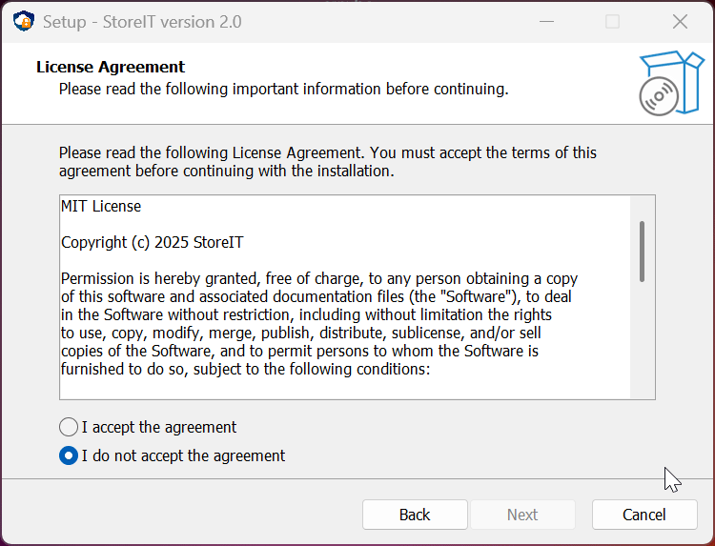
Step #4
Read the license agreement of the application. Then, accept it and click Next.

Slide 6
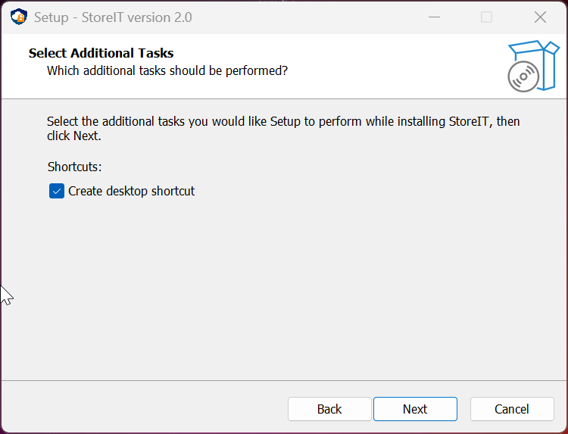
Step #5
Choose whether you want to create a shortcut to the application on your desktop or not. Then, click Next.

Slide 7
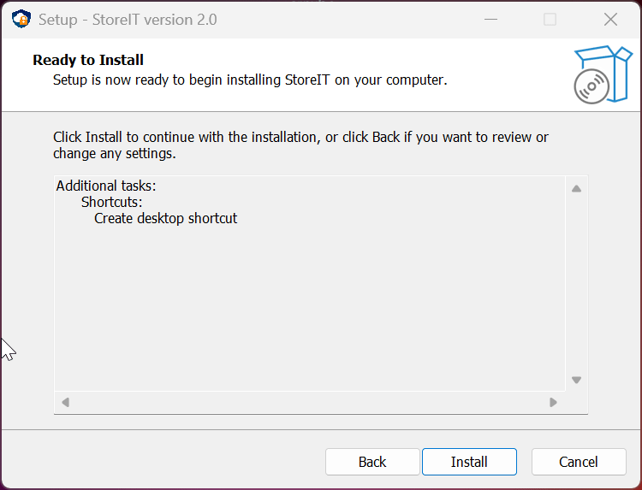
Step #6
This is the final step before installation. You can click Back to review or change any of the previous steps. Once you're ready, click Install.

Slide 8
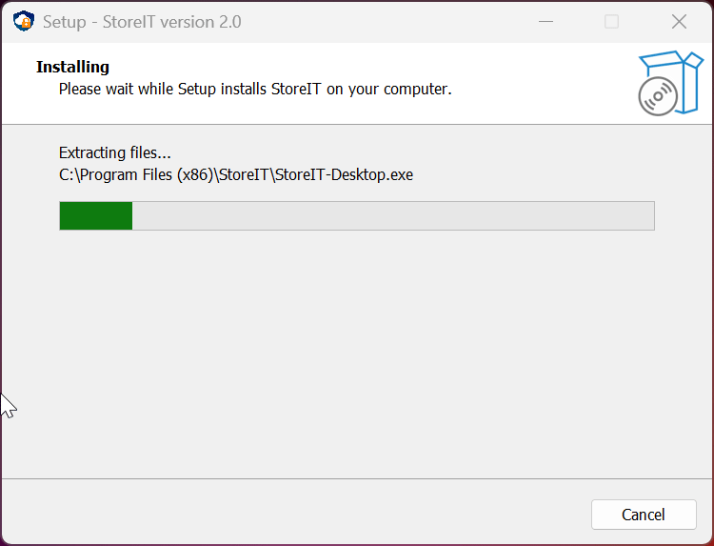
Step #7
Wait for the installation to complete and click Finish to close the installer.

Slide 9
Congratulations, you have successfully completed the installation of StoreIT Desktop!
We hope you enjoy the app. Consult the other application manuals and/or the README.md files available in the respective repositories for more information.

